Slide 1

LifeSpan Project
Strategies in detail

Slide 2

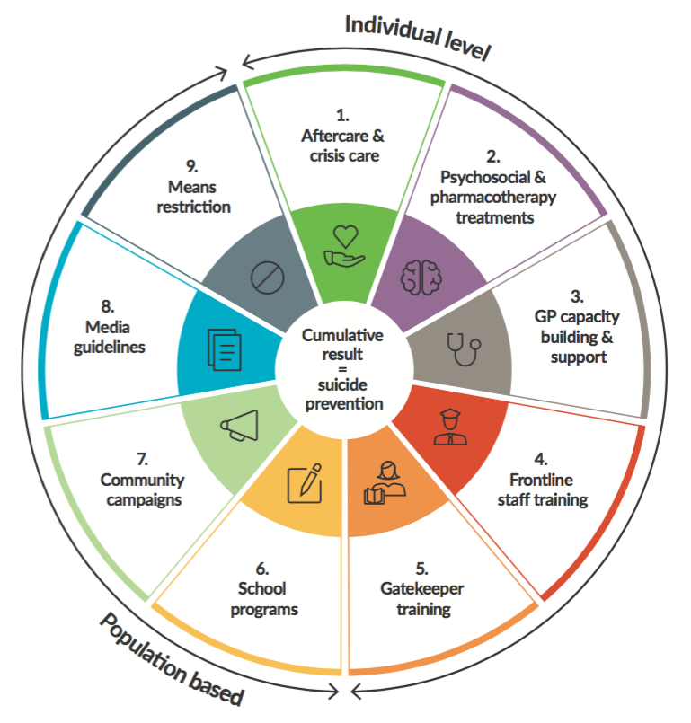
Work Streams
1: Health interventions
  strategies 1, 2, 3, 4
2: Community interventions
  strategies 5, 7, 8
3: School interventions
  strategy 6
4: Data driven suicide prevention
  suicide audit, service atlas, strategy 9
5: Indigenous suicide prevention
  applies across all strategies

Slide 3
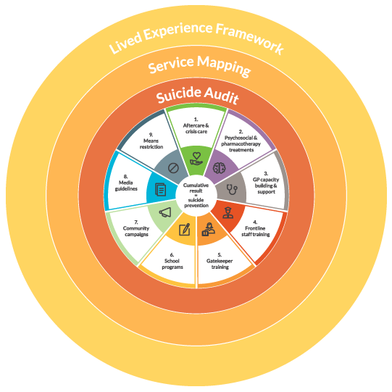
WG1 – Health interventions

Slide 4
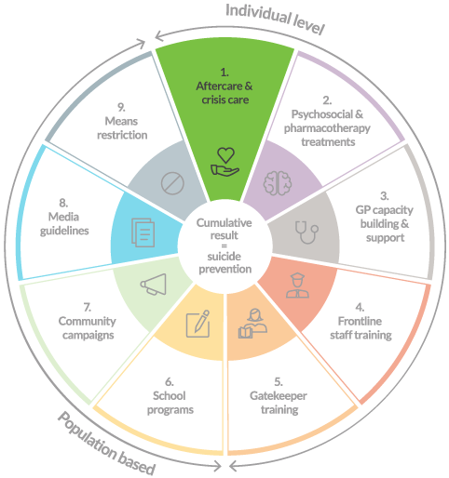
S1: Aftercare & crisis care
Problem
Individuals at high risk post- attempt ED environment is high pressure, time/resource poor Negative attitudes of ED staff Current protocols poorly implemented Coordination of care is highly complex Patients & carers/family needs are not well met

Slide 5
S1: Aftercare & crisis care
Interventions
Develop best practice guidelines Deliver training to ED/hospital staff Define & implement an aftercare service model Improve meaningful information sharing between care providers Local collaborative multidisciplinary networks, professional development events Local resource packs for patient & carers/family

Slide 6
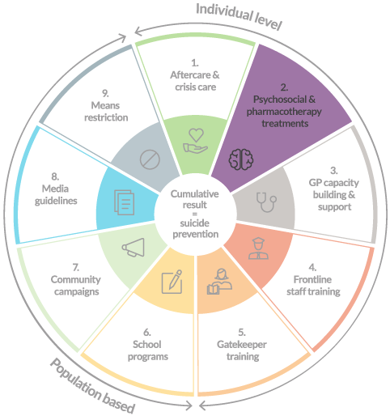
S2: High quality treatments
Problem
Psychiatrists/Psychologists Unaware of or not trained in best practice care/treatment Hard to keep pharmaceutical knowledge current Limited integration, information sharing between care providers (incl. ED, aftercare, GP) Clients/patients find it hard to identify/access best practice care

Slide 7
S2: High quality treatments
Interventions
Deliver Advanced Suicide Prevention training to clinicians Disseminate guidelines, resources Promote use of telehealth, e-mental health tools Implement improved consent tools Build & support local collaborative multidisciplinary networks, professional development events

Slide 8
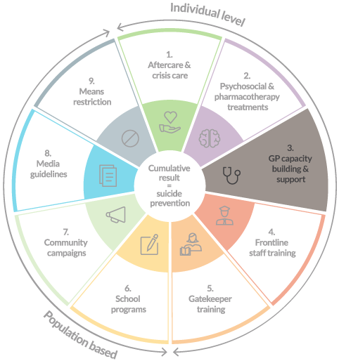
S3: GP capacity building
Problem
Missed opportunities to identify & support people in crisis (or earlier) GPs: Time poor, competing demands Unaware of or not trained in best practice care/treatment Struggle to identify appropriate referral points Difficult role in care coordination when services not integrated Hard for patients to raise suicidal thoughts (stigma, fear) Delays before able to access psychological care

Slide 9
S3: GP capacity building
Interventions
Deliver Advanced Suicide Prevention training to GPs Equip practices with BDI “StepCare” platform Universal screening for depression, anxiety, suicidality Conversation scripts Auto-generate mental health treatment plan Current referral pathways incl. online tools Ongoing alerts to assist monitoring of patients Build & support local collaborative multidisciplinary networks, professional development events

Slide 10
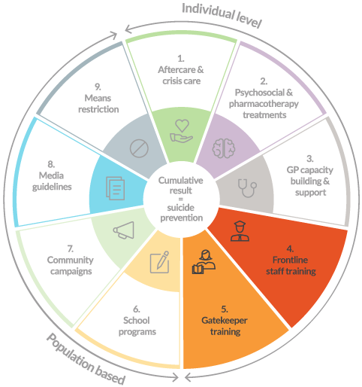
S4: Training frontline staff
Problem
Missed opportunities to identify and support people in crisis Fear, stigma, lack skills Existing training packages for frontline staff (police, paramedics) may need updating Local referral pathways/resources often unknown

Slide 11
S4: Training frontline staff
Interventions
Suicide Audit to facilitate data-informed, local gatekeeper strategy Deliver evidence-based gatekeeper training Plus ongoing activity to help with skills maintenance Subsided to aid adoption Equip GK with local referrals & resources Develop & drive workforce competencies Aim to embed training in roles/jobs Match training with required competencies

Slide 12
WG2 – Community interventions

Slide 13
S4: Training frontline staff
Problem
Missed opportunities to identify and support people in crisis Fear, stigma, lack skills Existing training packages for frontline staff (police, paramedics) may need updating Local referral pathways/resources often unknown

Slide 14
S4: Training frontline staff
Interventions
Suicide Audit to facilitate data-informed, local gatekeeper strategy Deliver evidence-based gatekeeper training Plus ongoing activity to help with skills maintenance Subsided to aid adoption Equip GK with local referrals & resources Develop & drive workforce competencies Aim to embed training in roles/jobs Match training with required competencies

Slide 15
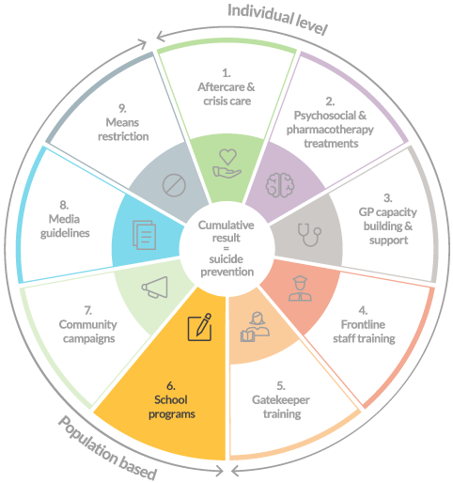
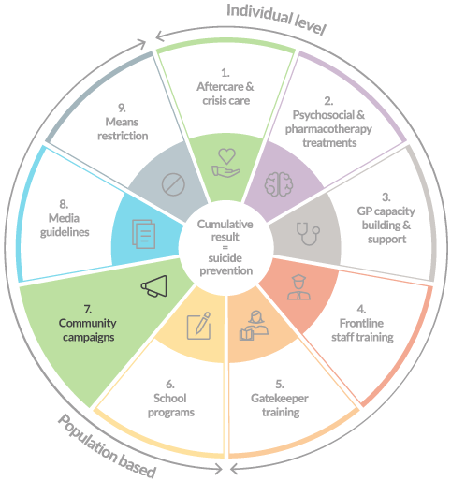
S7: Community campaigns
Problem
High stigma & poor literacy barriers to giving & getting help Limited promotion/awareness of local help resources Communities only hearing ‘bad news’ Not harnessing local energy to get involved

Slide 16
S7: Community campaigns
Interventions
Support sites in proactive communications planning ‘Boost & localise’ existing high quality awareness campaigns LifeSpan Community Champions program Harness local energy to get involved in LifeSpan Support implementation of all LifeSpan strategies

Slide 17
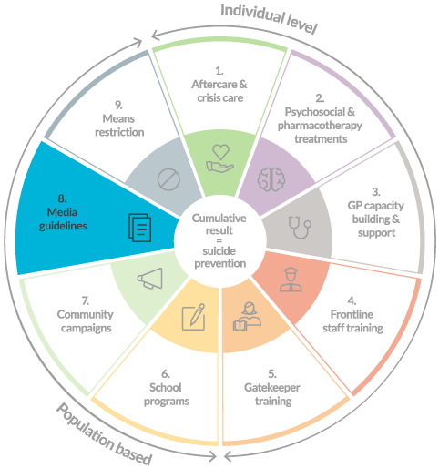
S8: Media guidelines
Problem
Poor reporting can do harm Misunderstanding & fear of media guidelines Local agencies take reactive, uncoordinated approach to media

Slide 18
S8: Media guidelines
Interventions
Proactive approach to media via communication planning, relationship building ‘Support After Suicide Protocol’ plans local response to critical events incl. media Mindframe media training for local media & mental health organisations Train & support people with lived experience to share story

Slide 19
WG3 – School interventions

Slide 20
S6: School programs
Problem
Young people vulnerable to suicidal behaviour, opportunity for prevention/early intervention Schools: Communities demanding action Want quality programs but don’t know how to choose Lack care/referral pathways

Slide 21
S6: School programs
Interventions
Recommend & support delivery of: Youth Aware Mental Health (YAM) Others: Signs of Suicide; Sources of Strength Build care pathways, into & out from school

Slide 22

Youth Aware of Mental Health
Who is it for?
14 – 16 year olds
What is it?
Educational program delivered in the classroom setting by accredited trainers
Constructed around 6 main themes that are communicated through lectures and role plays:
    What is mental health?
    Self-help advice
    Stress and crisis
    Depression and suicidal thoughts
    Helping a friend in need
    Who can I ask for advice?
Results
YAM has been shown to reduce depression and anxiety, suicide attempts, and severe suicidal ideation and facilitates healthy lifestyle choices among European youth.
Costs:
$8 per student (for work booklet)

Slide 23
Youth Aware of Mental Health

Slide 24
Youth Aware of Mental Health
Opening session | Role play 1 | Role play 2 | Role play 3 | Closing session
Overview Rights and rules Emotional rollercoaster Everyday mental health No one is free from problems Dealing with problems Stress, causes Crises Simple tricks to feel better Bullying and parents fighting Feeling sad v’s depression How do you know if you’re depressed? Severe depression A friend in need How do you know if someone isn’t feeling well? Listen, tell an adult Everyone needs help sometimes | Everyday choices and the outcome of one’s actions Participants are presented with certain dilemmas to discuss, e.g. | Becoming aware of one’s feelings and how to manage stress and crises situations Own examples When parents fight role-play Exclusion and bullying role-play | Listening to others and speaking about depression and suicidal thoughts E.g. 1. Eric fights with his parents; he thinks that everyone around him is horrible. He sleeps badly, starts to drink a lot of alcohol and stays away from school | Content prepared by YAM Instructor Contingent on climate, questions and concerns of the groups Summarise what has been learnt Contact details for local health care and other community support

Slide 25
WG4 – Data driven suicide prevention

Slide 26
Resource atlas
DATA SOURCES
PORTAL
PRODUCTS
Suicide Prevention Service Mapping Framework
What info is needed, how it is categorised, facility, services provided, practitioner profile, client demographic
BLACK DOG MASTER DATABASE >>
FUTURE STATE PUBLIC RESOURCE
SENSIS Data collections
MAPS
HealthDirect Data
ANU GRAPHC PORTAL: Geospatially maps the service data, enables BDI add fields for consistent capture
Report on baseline of region
Data cleaning to remove duplicates
Site held databases
Produce reports on existing data for a site (could be spreadsheet/report)
Process Outcome
Individual org/staff
Sites capture remaining data using two formats
ANU data in GRAPHC portal
Face to face interviews
Surveys distributed to staff

Slide 27
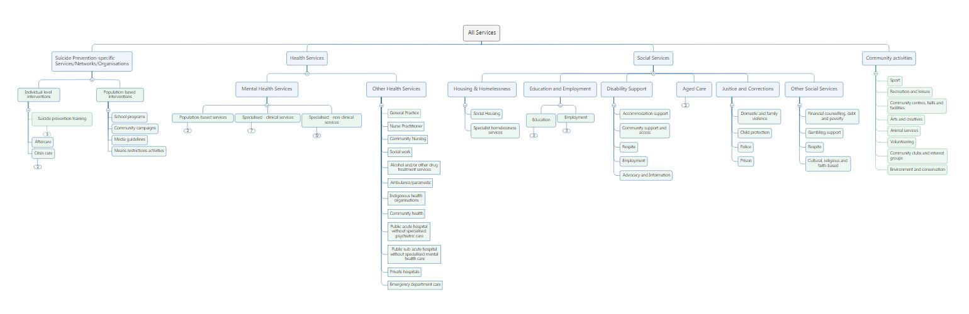
Service taxonomy

Slide 28
Suicide audit
Aims: Bring together primary data sources on suicide deaths and attempts which will be geospatially mapped to help identify trends and high-risk groups vulnerable to suicide; form the basis of the means restriction strategy and provide a data-driven approach to informing the development of local LifeSpan Suicide Prevention Action Plans.
Primary data sources
NSW Police data, NCIS, NSW Health, Ambulance data, Headspace youth suicide register
Process
BDI to access, code, interpret and analyse data from four primary sources to produce Suicide Audit Report
Local focus group (local health services, emergency services and community groups) on existing data use and needs, identifying additional data sources, determining if data align or differs with local perceptions and establishing preferred format and content of audit report (level of detail, frequency.
Sites develop means restriction plan

Slide 29
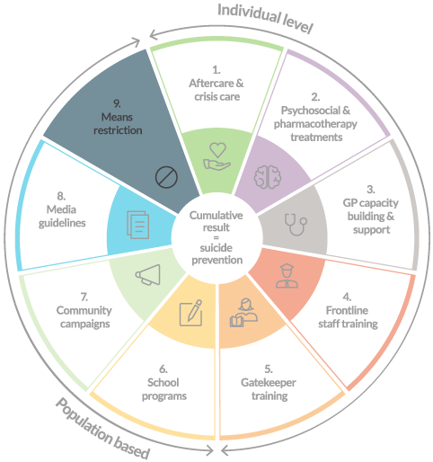
S9: Means restriction
Problem
Limited data on trends in means Not local Long delays No ongoing, local, strategic approach to restricting means

Slide 30
S9: Means restriction
Interventions
Suicide Audit to facilitate data-informed, local means restriction strategy Evidence review to identify means restriction opportunities Help sites take action: Seed funding for capital means restriction efforts at ‘hotspots’ Residual funding for innovation Policy responses for means restriction at State/Cth level

