Slide 1
ELOURA ACUTE ADMISSION AREA AND ELOURA HIGH CARE MENTAL HEALTH UNITS
PROJECT OVERVIEW:
‘THE PRODUCTIVE MENTAL HEALTH WARD’
2017-2018

Slide 2
INTRODUCTION
PROJECT LEADER:
Robyn Macgregor, NUM, The Eloura Units, ISLHD MHS
CLINICAL LEADER:
Pamela Park, NUM1, The Eloura Units, ISLHD MHS
EXECUTIVE SPONSOR:
Erin Hiesley, Shellharbour/Shoalhaven Operations Manager
PROJECT TITLE:
The ‘Productive Mental Health Wards’ (PMHW) – also known as “Releasing Time to Care”

Slide 3
SITUATION
The PMHW project aim is to increase direct care time to consumers by utilising components of ‘lean’ methodology such as implementing “Wow”, i.e. “Well Organised Ward” and “Ways of Working”.
The PMHW project also looks at processes that when improved increases consumer satisfaction, improves staff wellbeing and improves patient safety and reliability of care.

Slide 4
BACKGROUND
Designed by the NHS Institute for Innovation and Improvement to release more time to care for frontline staff who were typically spending only 25%-35% of time providing direct care
Draws on “lean” improvement techniques that encourage frontline staff and management to work together to improve patient care
Staff are trained to observe and analyse their own work processes to determine improvement priorities for their work practices

Slide 5
Underpinning principles
Patient centred– improving quality of care for patients
Has measurable benefits at all levels – fosters continuous improvement
Helps staff to understand and use everyday data
Reduces variation and waste using lean methodologies
Has a positive staff impact - improved team working
Simple to understand with modular structure
Modules are leadership methods rather than improvement tools

Slide 7
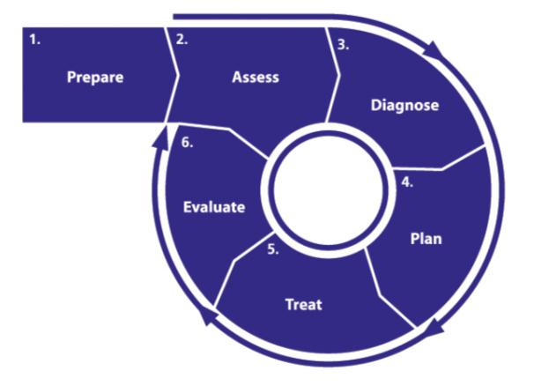
This is the process for working through the modules
Based on generic “Plan, Do, Study, Act” improvement cycle
A no-nonsense approach
Why teach clinical staff a new problem solving technique when they use one every single day?
Notes:
Each module follows this problem solving loop
Rather like PDSA but there is an important element to this:
This loop is based on the nursing care cycle.
Why would you teach ward staff a new problem solving loop (such as PDSA or DMAIC) when they already use one every day?
This illustrates the ‘no-nonsense’ and very accessible nature of the PW

Slide 9
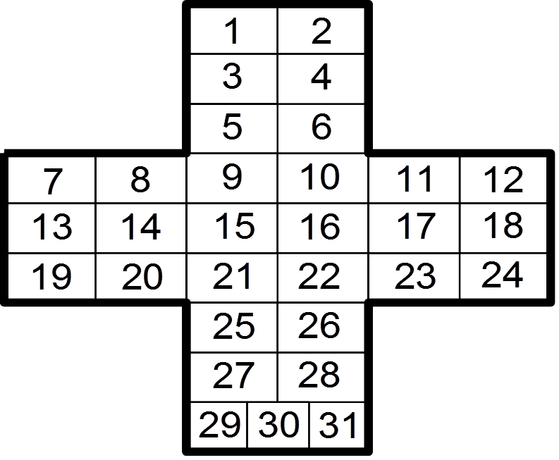
Assessment
Multiple methods of assessment including:
“Knowing How We are Doing” boards
Activity Follows
Safety Crosses (Falls, medication errors)
Graphing seclusion, restraint and aggressive incidents, Staff sick leave
Consumer, Carer and Staff surveys

Slide 10
© Copyright NHS Institute for Innovation and Improvement 2007-2008
Notes:
10
Note that the measures in blue are ones which can be collected on the ward but red measures would require input from Information Service departments

Slide 11
Expected Benefits to Consumers and Staff
Increase in direct care time to consumers
Increased Consumer (and Carer) satisfaction
Well Organised Ward (WOW)
Cost savings from WOWing (reviewing Stores and medication usage)
Increased staff satisfaction and wellbeing
Improved Activity Programs
Well structure ward routine
Improved consumer and staff safety

Slide 12
Real Time Planning
Six Eloura Staff (including NUM3 & NUM1) will attend the two day workshop on 27th and 28th June in Sydney.
Module Leaders will be assigned
Project and Clinical Leaders will involve team in planning, monitoring, evaluating each module and communicate progress to the rest of the Team and Senior Management/Executive Sponsors.
Attend further workshops over next 18 months where achievements will be showcased and have the opportunity to steal shamelessly the ideas of other teams.

Slide 13
Eloura HC Specific Projects
Improve activity program (nurse led activities)
Managing Drug Induced consumers with high levels of aggression.
Reintroduce Sensory Modulation (training to staff)
Continue to improve environment (courtyard recently painted)
Section 33 assessment in ED’s
Six Core Strategies to reduce Seclusion and Restraint implementation.

Slide 14
Introduction: Reduction of seclusion and restraint
In 2005, health ministers endorsed the national safety priorities in mental health, including "reducing use of, and where possible eliminating, restraint and seclusion".
Seclusion is defined as the confinement of a patient at any time of the day or night alone in a room or area from which free exit is prevented.
Restraint is defined as the restriction of an individual’s freedom of movement by physical or mechanical means.
Situation: The health ministers agreed seclusion and restraint were serious infringements of an individual's rights, and can cause psychological trauma and physical injury to consumers and to health-care staff.

Slide 15
Recent events....
Lismore Base Hospital – death of female in seclusion June 2014, naked , repeated falls, no medical review – lead to media coverage May 2017.
NSW Health Minister Brad Hazzard and Mental Health Minister Tanya Davies to launch a parliamentary inquiry and an independent investigation into the use of seclusion and restraint of mental health patients across NSW.

Slide 16
Use of 6 core strategies, ‘best practice’, to reduce the incidence of seclusion and restraint.
1.Leadership sets clear goals based on a vision or policy goals.
2.Using data to inform practice.
3.Workforce development.
4.Prevention strategies.
5. Full inclusion of peers/families.
6.Rigorous debriefing.

Slide 17
Assessment....
Reduction in number of seclusion events, duration of seclusion events and number of incidences of restraint...aim for none!
Provide “trauma informed care”
Improvement in person centred language
Increased consumer participation and satisfaction
Increased staff and consumer participation, reduction in conflict, consumer and work related injuries.

Slide 18
Real time planning
2 day training already conducted in Sydney May 2017....staff enthusiastic and motivated to contribute.
Productive wards training June 2017 ....6 staff to champion / target key areas for improvement.
Continuing involvement with the ISLHD MHS Seclusion and restraint committee.

